Slide 1
MANAGEMENT INFORMATION SYSTEM
(MIS)

Slide 2
Content
What is Management Information System
Meaning of MIS
Functions of MIS
Characteristics of MIS
Role of MIS
Main objectives of a management information system
Benefits of MIS

Slide 3
What is MIS
Management Information System is a computer based information system which is basically concerned with processing data into information which is then communicated to the various departments in an organization to support the operations ,the management and the decision making functions in the organization

Slide 4
Meaning of MIS
Management information System or MIS broadly refers to a computer based system that provides managers with the tools to organize,evaluate and efficiently manage departments within an organization

Slide 5
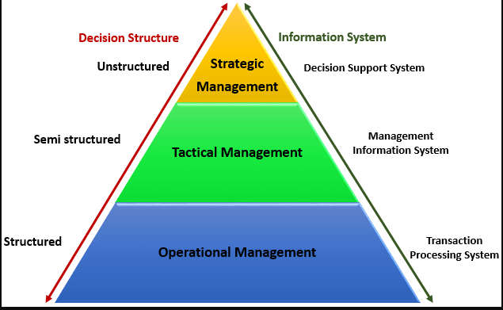
Level of MIS

Slide 6
Role of MIS
The role of MIS in an organization can be compared to the role of heart in the body. The information is the blood and MIS is the heart. In the body the heart plays the role of supplying pure blood to all the elements of the body including the brain. The MIS plays exactly the same role in the organization. The system ensures that an appropriate data is collected from the various sources, processed, and sent further to all the needy destinations.

Slide 7
Characteristics of MIS
Management-oriented: The basic objective of MIS is to provide information support to the management in the organization for decision making.
Management directed: When MIS is management-oriented, it should be directed by the management because it is the management who tells their needs and requirements more effectively than anybody else.
Integrated: It means a comprehensive or complete view of all the subsystems in the organization of a company.

Slide 8
Function of MIS
1.To improve decision – making : MIS helps management by providing background information on a variety of issues and helps to improve the decision making quality of management
2. To improve efficiency: MIS helps managers to conduct their tasks with greater ease and with better efficiency .This reflects in better productivity for the company
3. To provide connectivity : MIS provides managers with the better connectivity with the rest of the organizations

Slide 9
Benefits of MIS
Data can easily be accessed and analysed without time consuming manipulation and processing.
Decisions can be made more quickly and with confidence that the data are both time-relevant and accurate.
Integrated information can be also kept in categories that are meaningful to profitable operation.
Significant cost benefits, time savings, productivity gains and process re-engineering opportunities are associated with the use of data warehouse for information processing.
It promotes learning or training.
It increases organizational control.

Slide 10
Thank You

